Slide 1
Matlab
By
Saadan,Hassan, Ali, Fatima, Taimoor

Slide 2
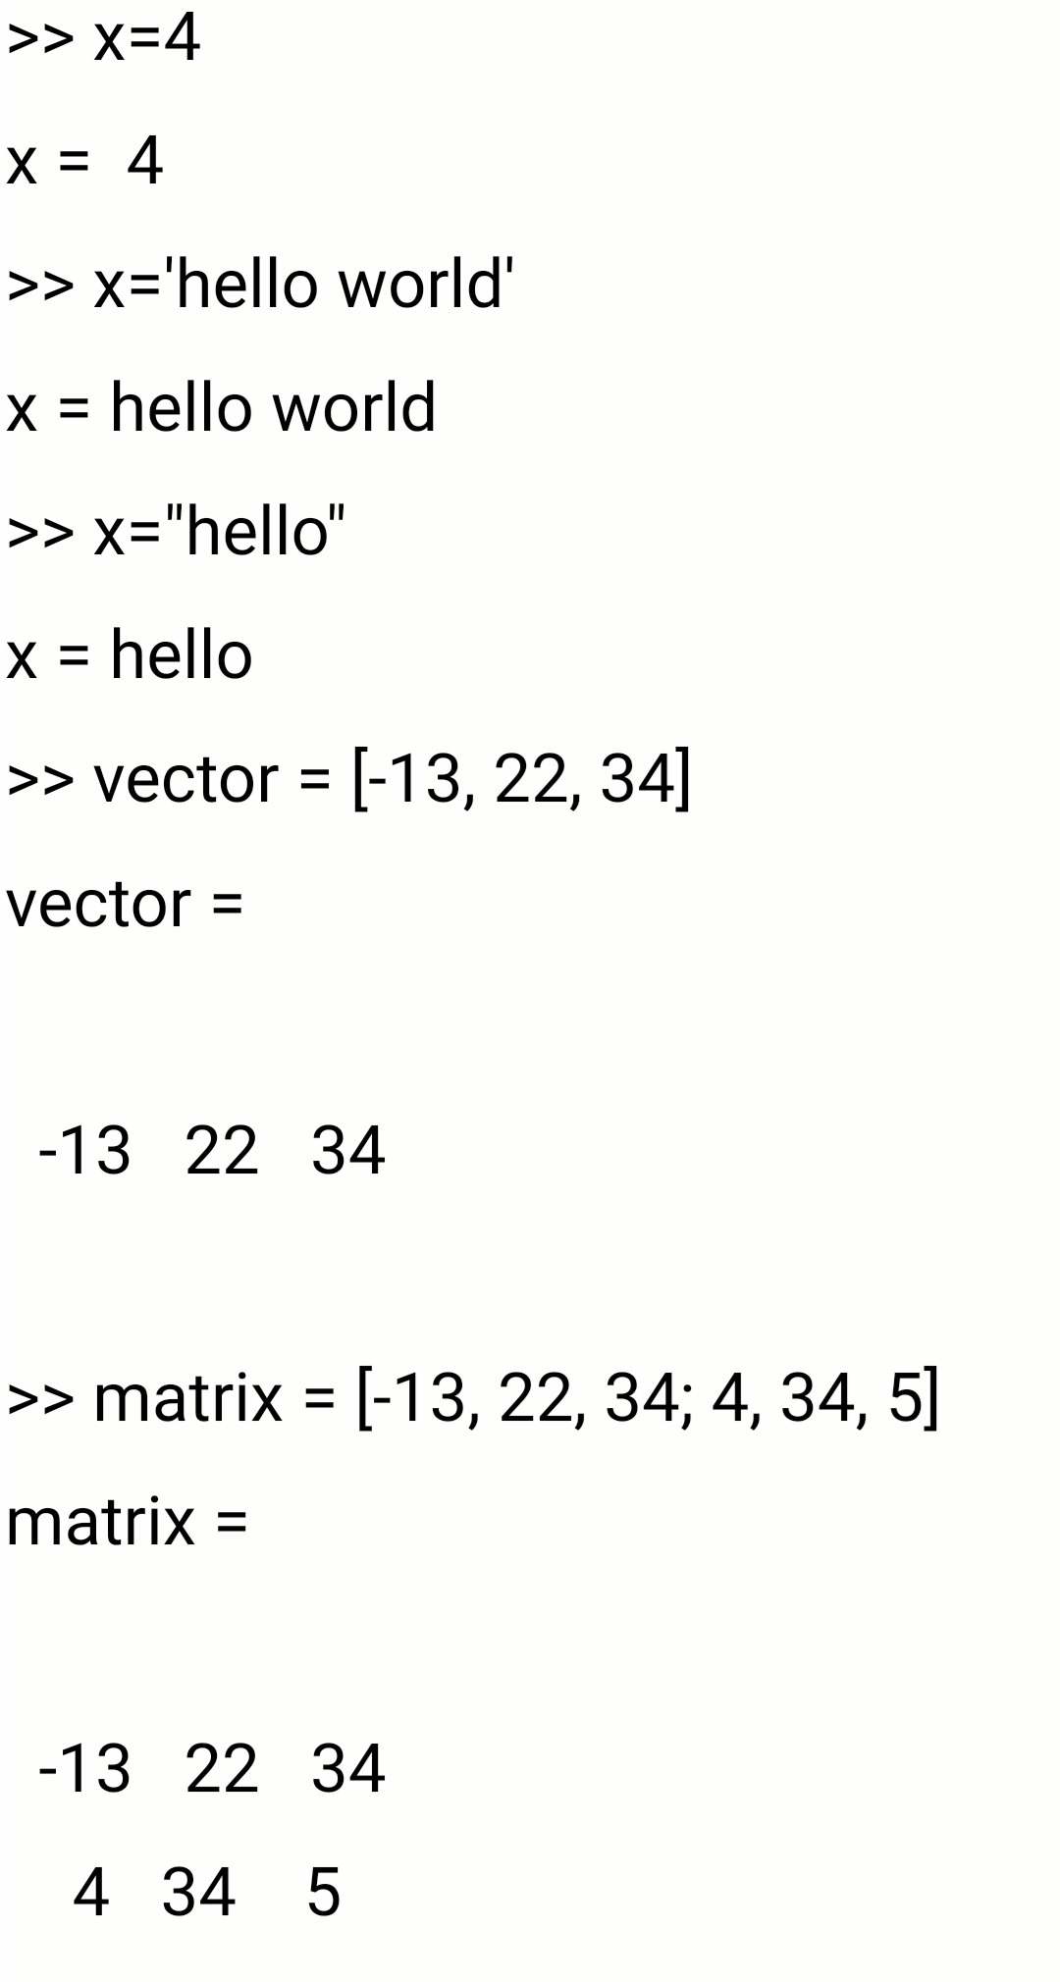
VARAIBALES
To initialize a varaible:
Variable name = Value
Value = integer/string
Vector initialize:
Vector name = [value1, value2, value3]
Matrix initialize/
Matrix name = [value1, value2, value3; value4, value5, value6

Slide 3
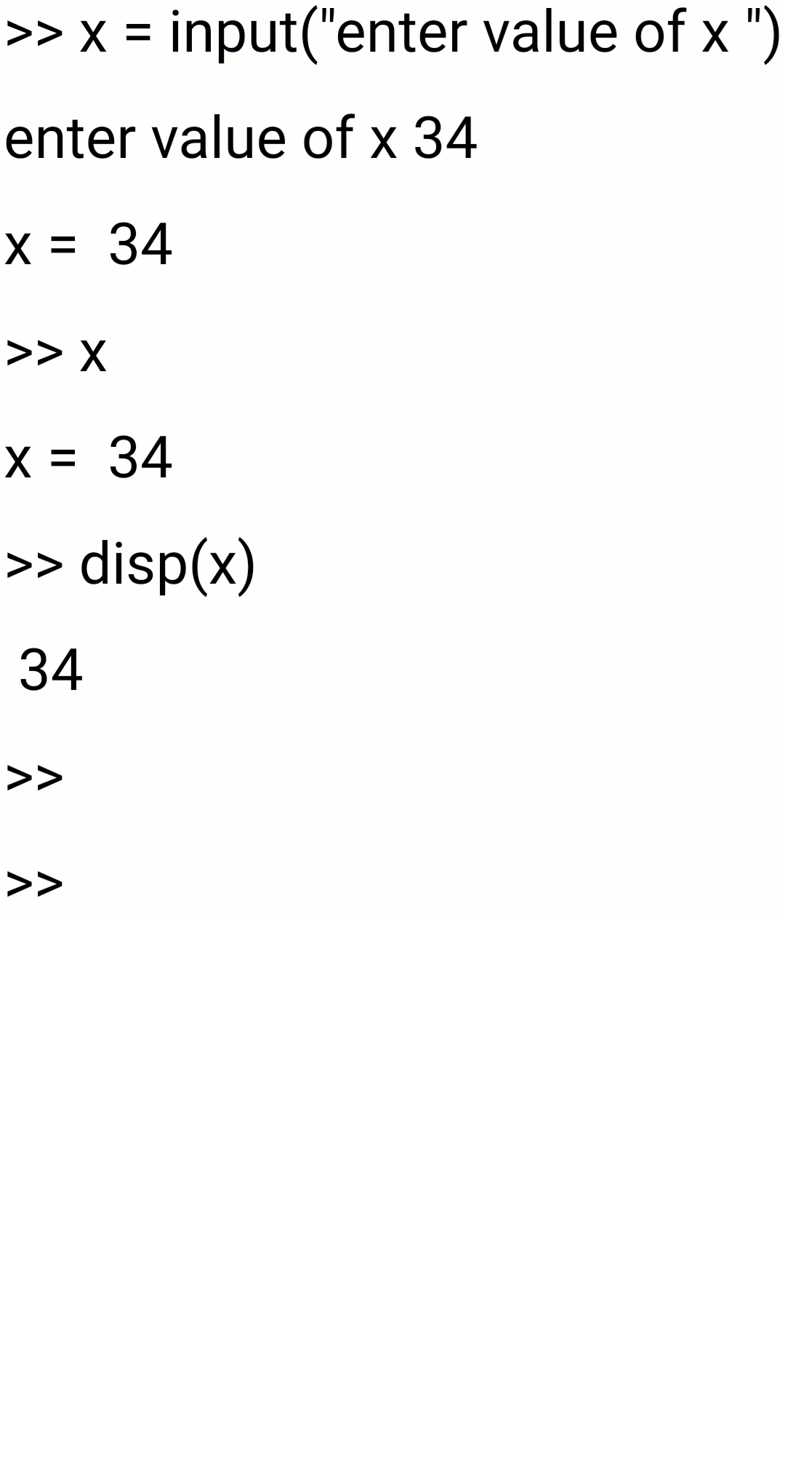
INPUT & OUTPUT
Input:
Variable name=(“prompt”)
Output:
Variable name
Disp(varaibale name)
Fprintf(“%i/n”, varaible, prompt)

Slide 4
2D PLOTTING
Figure
Plot(variable1, variable2)
Xlabel(‘… ‘)
Ylabel(‘… ‘)
Title(‘... ‘)
Grid minor
Hold on

Slide 5
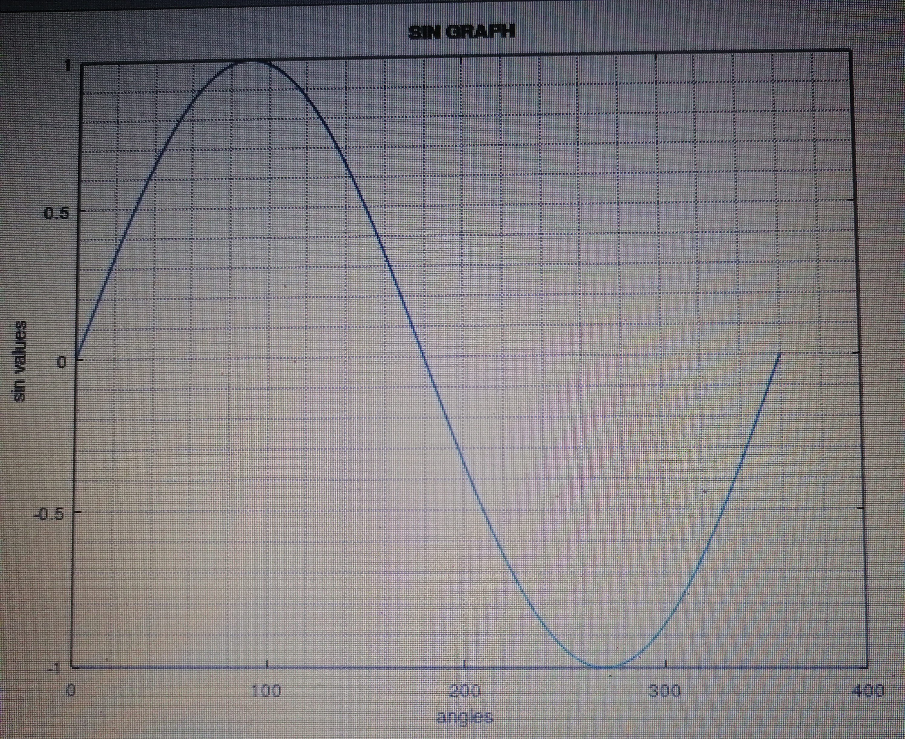
2d Plotting Example Sin Graph
x=0:0.1:360
Y=sind(x)
Plot(x, y)
Xlabel(angle)
Ylabel(‘sin values’)
Title(‘SIN GRAPH’)
Grid minor

